Slide 1
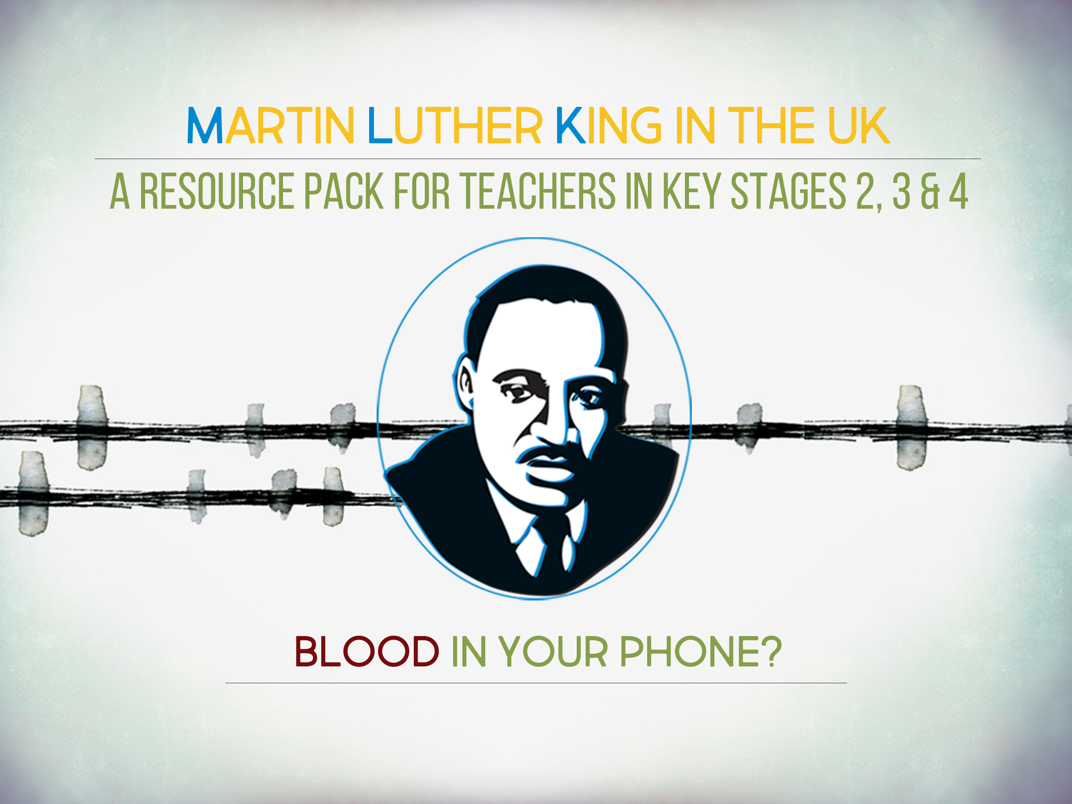

Slide 2

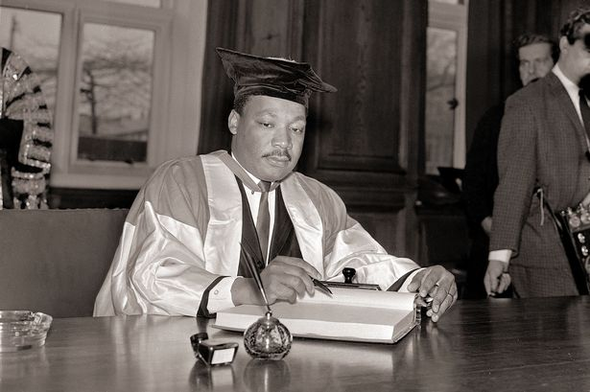
“We have got to come to see that the destiny of white and coloured persons is tied together. In a real sense we are caught in an inescapable network of mutuality.”
- Dr. Martin Luther King Jr., Newcastle, 1967.
Notes:
King had a strong belief that all humans were connected to each other. In our global world, what affects one community affects all. Therefore war racism, poverty and war anywhere should matter to everyone everywhere.

Slide 3
“Whatever affects one directly, affects all indirectly. We are made to live together because of the interrelated structure of reality. Did you ever stop to think that you can't leave for your job in the morning without being dependent on most of the world? You get up in the morning and go to the bathroom and reach over for the sponge, and that's handed to you by a Pacific islander. You reach for a bar of soap, and that's given to you at the hands of a Frenchman. And then you go into the kitchen to drink your coffee for the morning, and that's poured into your cup by a South American. And maybe you want tea: that's poured into your cup by a Chinese. Or maybe you're desirous of having cocoa for breakfast, and that's poured into your cup by a West African. And then you reach over for your toast, and that's given to you at the hands of an English-speaking farmer, not to mention the baker. And before you finish eating breakfast in the morning, you've depended on more than half of the world. This is the way our universe is structured, this is its interrelated quality. We aren't going to have peace on earth until we recognize this basic fact of the interrelated structure of all reality.”
- Martin Luther King, A Christmas Sermon on Peace, 1967.

Slide 4
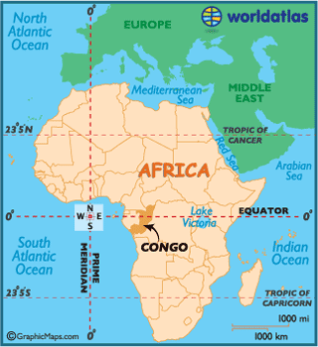
Notes:
We are going to look at King’s vision of global responsibility and the relationship between us in the UK and the DRC.

Slide 5
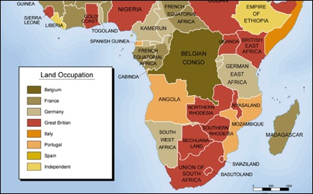
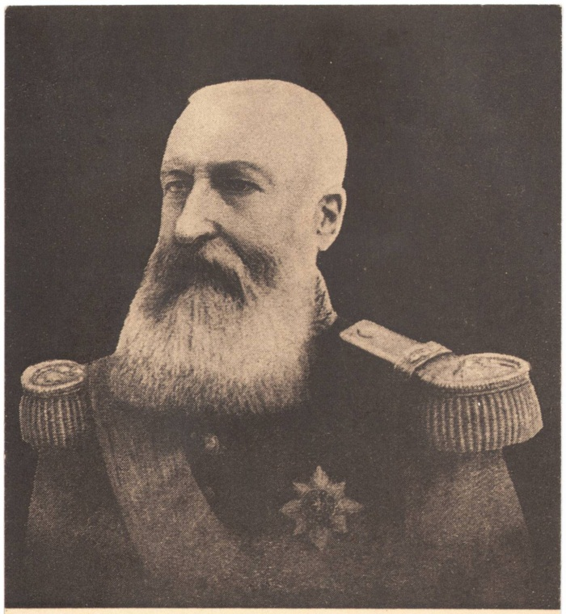
Southern and Central Africa before World War I
King Leopold II of Belgium
Notes:
In the colonial period Congo was ruled by Belgium. In 1885 the King of Belgium., Leopold, made it a private slave colony.
In the early twentieth century the world’s booming rubber industry – for example, for motor cars – was entirely dependent on Congo rubber. This made Leopold one of richest men in the world.

Slide 6
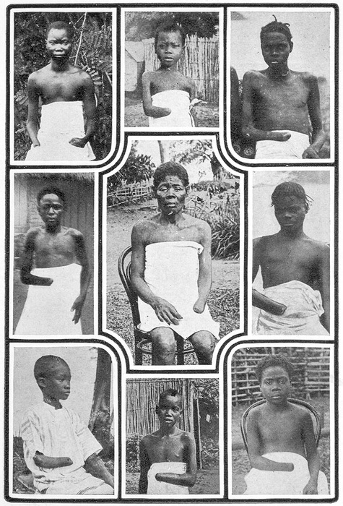
Notes:
But this had a severe cost for the people of the Congo. He policed it brutally: people had limbs cut off if they did not meet rubber production quotas, and the population of the country halved under his rule.

Slide 7
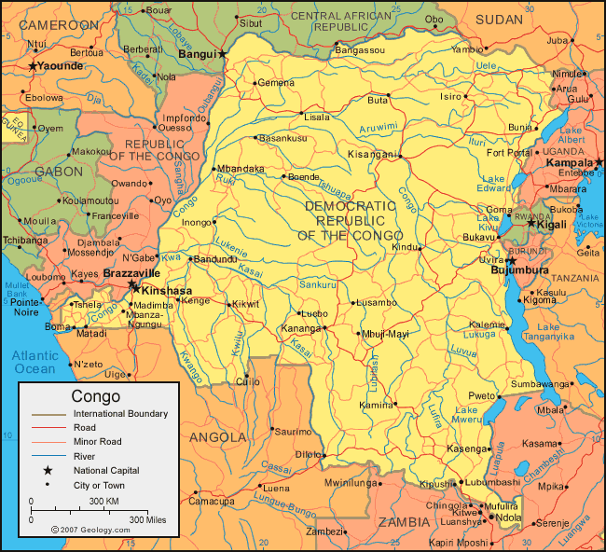
Notes:
Congo became independent in 1960. In the ‘Cold War’ – the rivalry between the United States and the Soviet Union, each side backed different local leaders sot there was constant war and corruption.

Slide 8
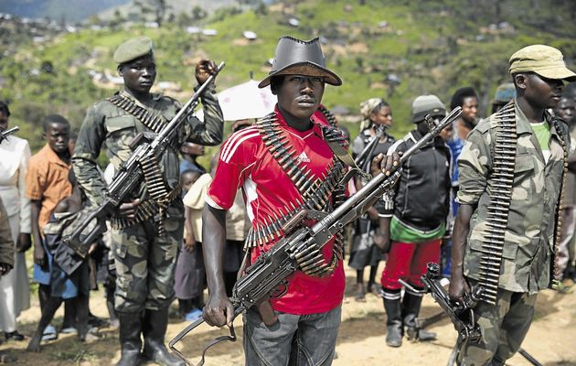
Notes:
After the end of the Cold War, in the late 1980s, the USA and Russia stopped sending money. The country descended even further into civil war, with warlords controlling different parts of the country. Rwanda and Uganda both invaded.

Slide 9
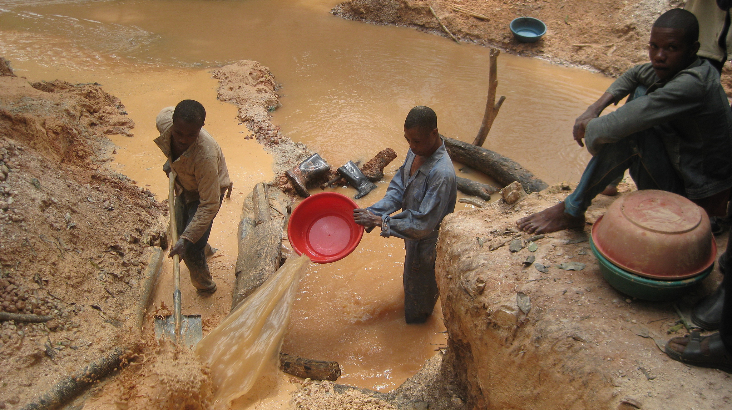
Notes:
These wars are significantly about resources: timber, gold, diamonds, metals. After invading, Uganda became a major exporter of gold and diamonds – despite having almost none of its own. It steals them and sells them on internationally. 5 million people have died in these wars since 1997 – the bloodiest conflict since World War 2.

Slide 10
In figures:
the UK and the Democratic Republic of Congo
 | UK | CONGO
Population (million) | 65 | 67
Population (US$/cap) | 35,000 | 320
Life expectancy at birth (M/F) | 78/82 | 47/51
Annual expenditure on health/cap (US$) | 3,480 | 27
Probability of dying 15-60 years of age, per 1000 people | 95/58 | 442/331
Notes:
And this history is one of the reasons why the people of Congo are so poor. If they had been paid fair prices for all their products over the past 130 years, and if this money had been used well by good rulers, Congo would be one of the richest countries in the world: yet it is one of the poorest.

Slide 11
“We have got to come to see that the destiny of white and coloured persons is tied together. In a real sense we are caught in an inescapable network of mutuality.”
Notes:
We established through the ‘opinion line’ exercise that our sense of responsibility extends to others.
But what, in particular, does all this have to do with us?

Slide 12
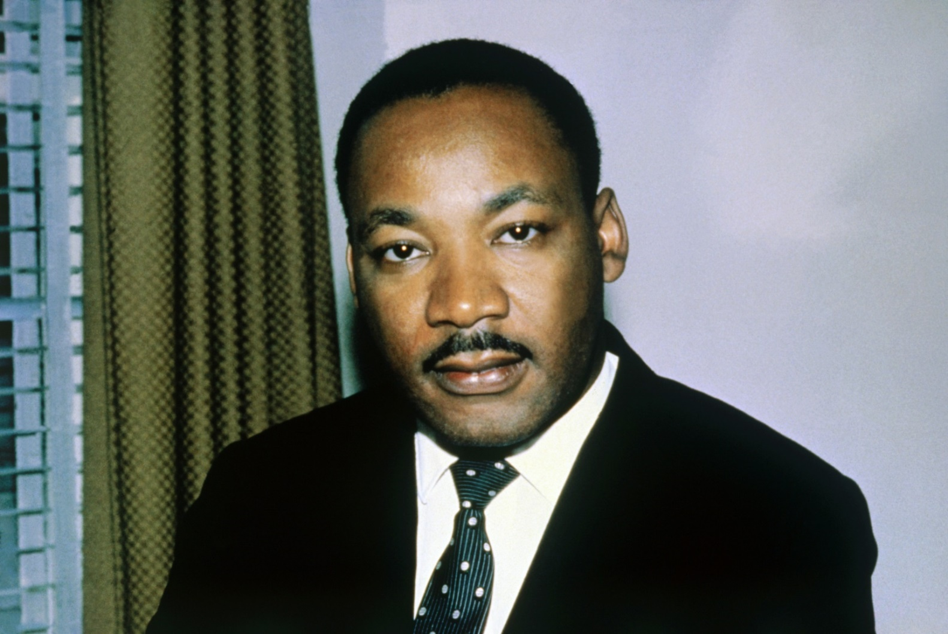
“The world in which we live is geographically one. The challenge that we face today is to make it one in terms of brotherhood.”
Notes:
Our geographical connection to others by commodity chains produces moral responsibilities. As King said: “The world in which we live is geographically one. The challenge that we face today is to make it one in terms of brotherhood.”
Teachers might wish to draw attention to King’s gendered language and ask students how this would be phrased today.

